Slide 1
CFA & SEM
Lecture 5

Slide 2
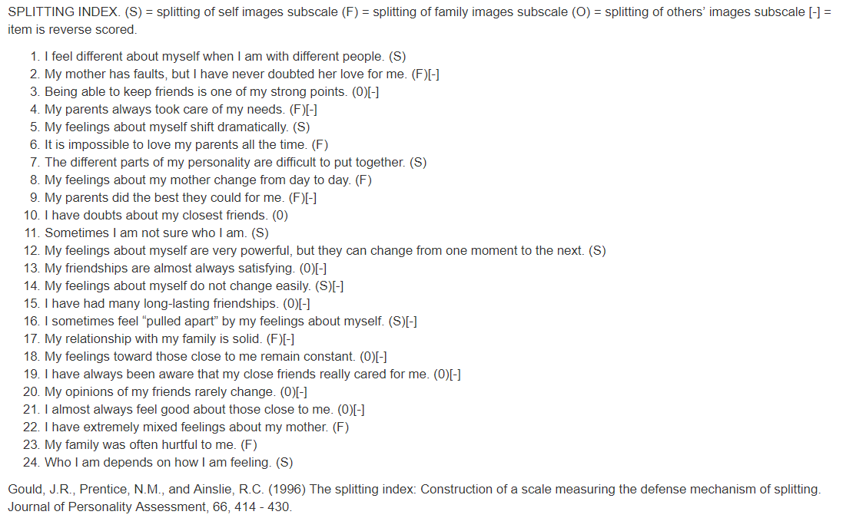
The return of the splitting index

Slide 3
What are we going to do today?
The quick summary of what you will do today is:
Open Amos.
Draw your model.
Name your factors.
Run your model.
Interpret the model output.
Add correlations between the factors and run the correlated model, and compare fits across models.

Slide 4
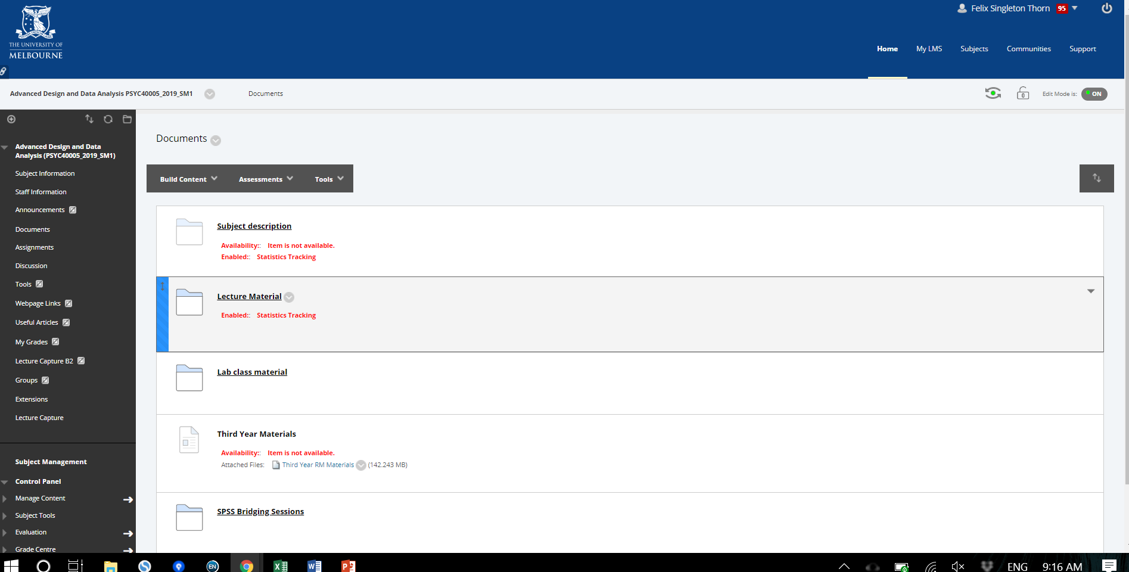
Download zip file from LMS

Slide 5
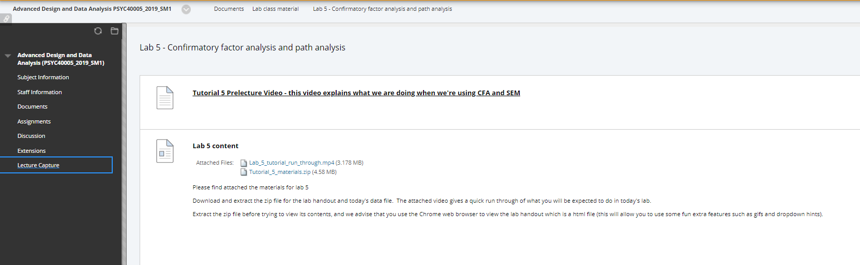
Download zip file from LMS

Slide 6
Unzip

Slide 7
Open that doc in Chrome

Slide 8
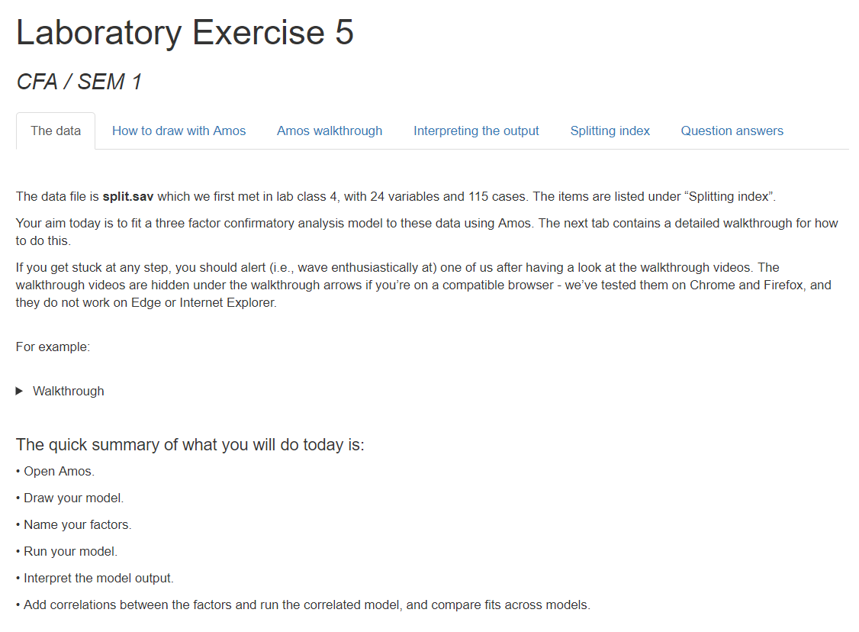

Slide 9
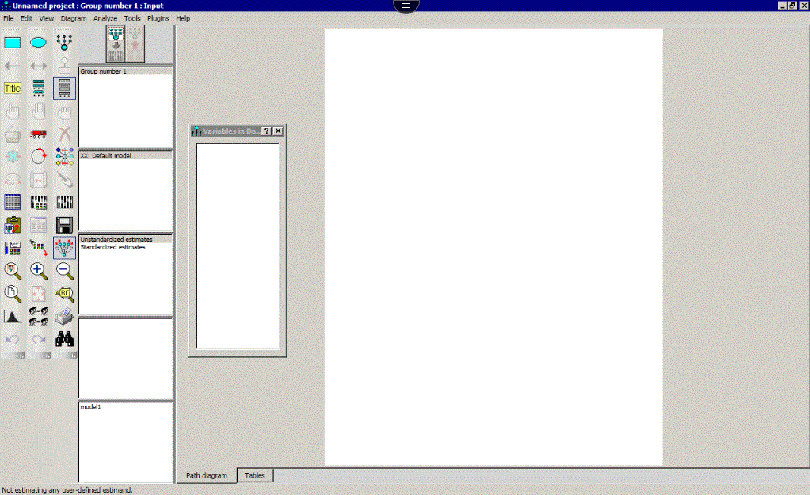
Open up AMOS the SEM software

Slide 10
Draw a single factor with 8 observed items

Slide 11
Copy your factor structure twice

Slide 12
Define each observed variable (i.e., open up your dataset, click and drag variables onto the boxes – your observed variables)

Slide 13

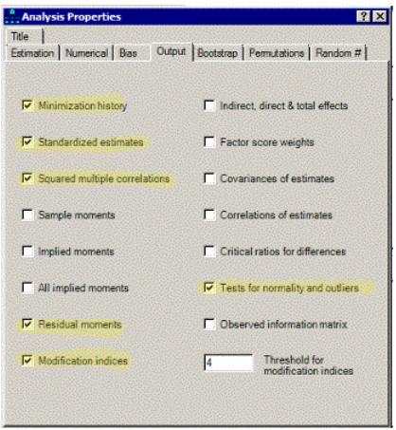
Set up some preliminary details (more details in the lab handout)

Slide 14
Settings we’re getting
Normally you would choose standardized estimates (as you should today).
In Amos by default, the factor loadings are unstandardised regression weights and the labels on the curved double headed arrows covariances. Standardized estimates restores the OG look of standardised regression weights and correlations.
Squared multiple correlations give us our communality estimates – i.e., variance explained of each observed variable
Residual moments gives us the residuals in the covariance and correlation matrix. We want to see our error terms. It means we can look not just at global fit but also local fit – i.e, we can see where our model sucks.
Select “modification indices” too, which allows us to see which changes would improve model fit the most (beware ad hoc changes to improve model fit at the cost of overfitting).
Tests for normality and outliers can be helpful too!

Slide 15

Run your model
I.e., Use the pixilated abacus

Slide 16
Interpret your model

